Slide 1

Collaborative Filtering for Life Insurance Products
Jairo Fernando Gudiño-Rosero
Sample of Work

Slide 2
Philosophy
Usual collaborative-filtering algorithms (Non-Matrix Factorization, Weighted Alternating Least Squares, Clustering, SVD, Deep Learning) cannot address information as correctly as simple heuristics when information of the objective is too few.
I build a collaborative-filtering algorithm based on:
Association Rules Algorithm
Heuristically built – Decision Trees

Slide 3
Business Context

Slide 4
What is the next best offer?
You are hired to build a collaborative-filtering algorithm for a life-insurance company in Latin America, but the market size is not too big and you must allocate 7 products with few available infomation.

Slide 5
Too limited information:
Channels: TLMK (Call-center) and Commercial Branches. If the customer uses both, you can offer 2 products at most.
Features (almost not related): Income, total wealth, age, economic sector, state, if is retired, skilled-degree of the job, type of job-contract, relationship status, if has a mortgage credit, if has an account in large banks & employment status.
Observations: 88.000.

Slide 6
I. TLMK
II. Commercial Branches
S1
S5
S3
S6
S2
S4
S7

Slide 7
Statistical Facts

Slide 8
Statistical Facts: Association Rules
TLMK
81.6% (6.255) of educational sector-workers bought S1. 24.02% of total S1 costumers.
67.5% (3.648) of armed-forces listed people bought S2. 22.66% of total S2 customers.
47.2% (233) of retired people and living in the coastal area bought S3. 2.5% of S3 customers; the rest of retired people bought mostly S1 (80.1%, 3.646), being the 14% of total S1 customers.

Slide 9
Statistical Facts: Association Rules
2. Commercial Branches:
66.7% (4.614) of retired people bought S5. 49.7% of total S5 customers.
71.2% (10.767) customers working in health, construction, social services, public administration or specialized professionals or having an active mortgage credit or receiving monthly wages in large bank accounts or with temporary-contract jobs or in a free union relationship bought S7. 35.61% of total S7 customers.
70.5% (508) of armed-forces listed people bought S2. 21.47% of total S2 customers.

Slide 10
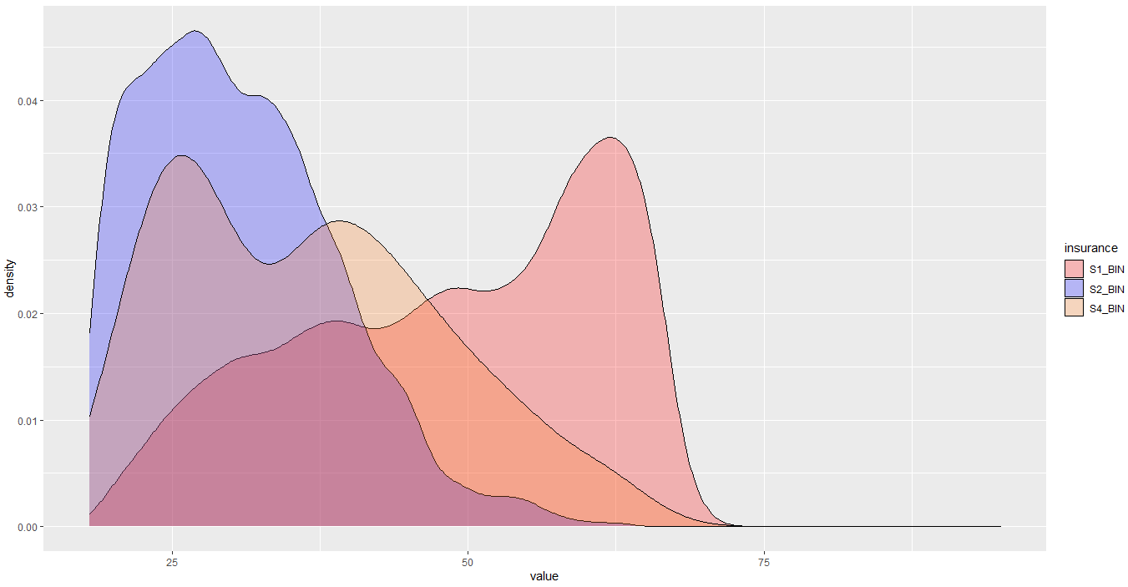
Statistical Facts: Empirical Distributions
Age:

Slide 11
Statistical Facts: Empirical Distributions
In TLMK:
After some filterings, decide the insurance to recommend according with the age of the customers: if age < 28, S2; if 28 <= age < 41, S4; if age >= 41, S1.

Slide 12
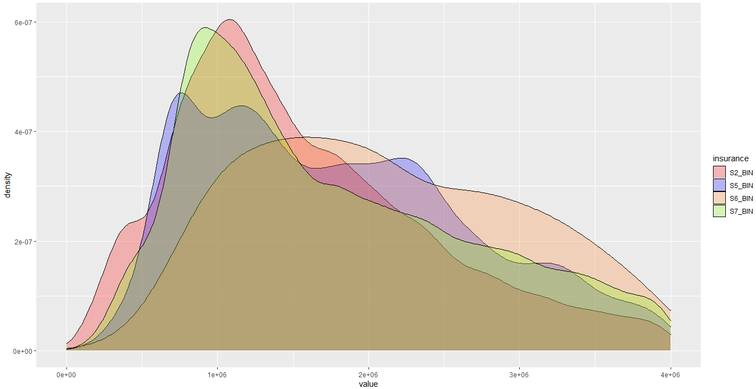
Statistical Facts: Empirical Distributions
Monthly Income:

Slide 13
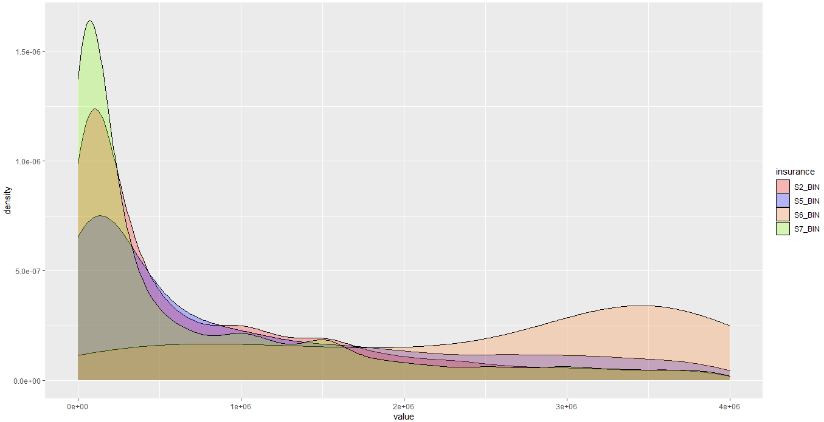
Statistical Facts: Empirical Distributions
Total Wealth:

Slide 14
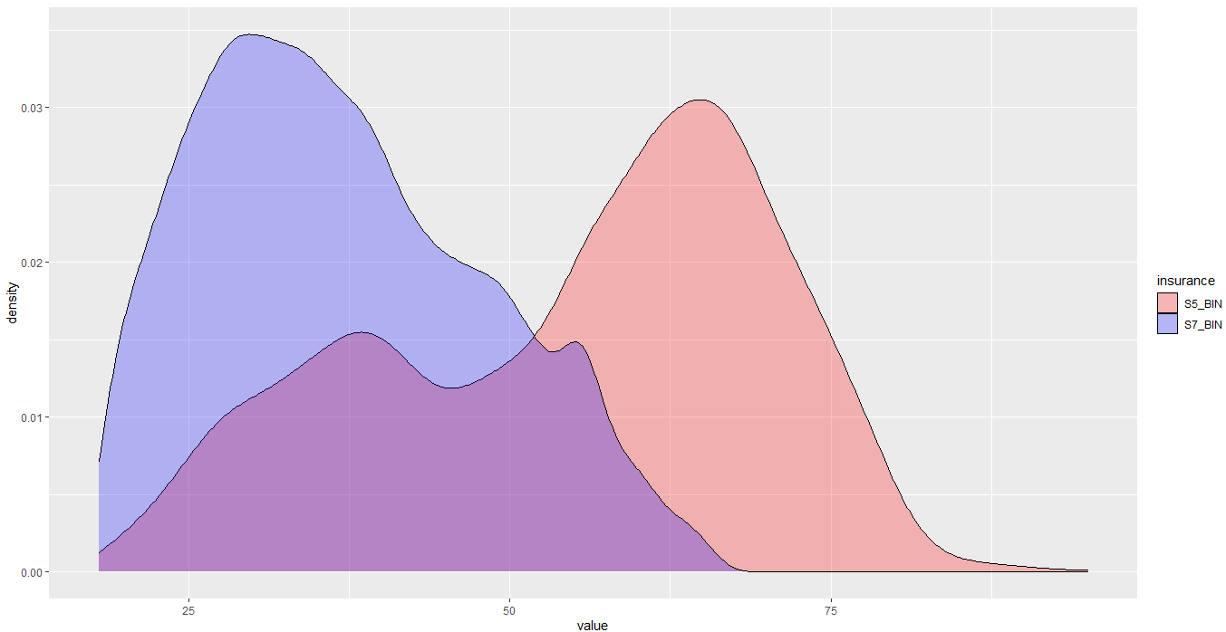
Statistical Facts: Empirical Distributions
Age:

Slide 15
Statistical Facts: Empirical Distributions
In commercial branches:
After some filterings, for customers with monthly income > 2M & total wealth > 2.5M, recommend S6 (2.5%, 170). This constitutes 58.02% of S6 total customers.
After some filterings, for customers with age > 55, S5 (53.7%, 476), encompassing 5.2% of S5 customers; otherwise, S7 (56.9%, 11.866 customers), encompassing 39.31% of S7 customers.

Slide 16
Results: Heuristical Decision Trees

Slide 17
Educational Sector?
I. TLMK
Live in the coastal region?
No
Armed Forces?
S1
Yes
Yes
S1
Retired?
S2
S3
S1
Age > 41?
S2
S4
Yes
Age > 28?

Slide 18
S6
Retired?
Total Wealth > 2M & Monthly Income > 2.5M?
S7
S5
Does the individual work for S7 Jobs?
S2
S5
Yes
Armed Forces?
Age > 55?
II. Commercial Branches
S7

Slide 19
Overall accuracy: Low-medium overall accuracy, medium-high accuracy within clusters identified.
*TLMK: * Commercial Branches:
S1: 68.29% - S2: 29.58%
S2: 68.57% - S5: 53.58%
S3: 2.5% - S6: 69.62%
S4: 30.59% - S7: 53.70%

Slide 20
Comparing other methods
I convert statistical facts to dummy and numerical variables and compare results with ML algorithms. I find is not straightforward for them to identify small differences, obtaining the accuracy power is not much better. Ensemble algorithms may be fruitful for calculating propensity scores and improve results.

Slide 21
Random Forests (with cross-validation and upsampling)
*TLMK: * Commercial Branches:
S1: 81.74% - S2: 22.89%
S2: 83.63% - S5: 27.9%
S3: 4.74% - S6: 0%
S4: 0% - S7: 44.57%

